Slide 1
Trans-Pacific Outlook 2019
Uncertainties in the International Supply Chain
April 30, 2019

Slide 2
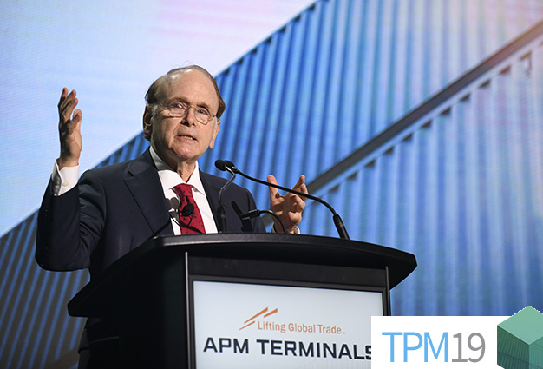
Low-sulfur rule roll-out coming 1-1-2020
Daniel Yergin, IHS Markit vice chairman:
The International Maritime Organization’s (IMO’s) low-sulfur fuel mandate for ocean vessels “is going to happen."
Lingering concerns on supply and how ship engines will handle the new fuel type, which doesn't have a standard formula.
Shipowners say there will be sufficient LSFO in east-west trade lanes.

Slide 3
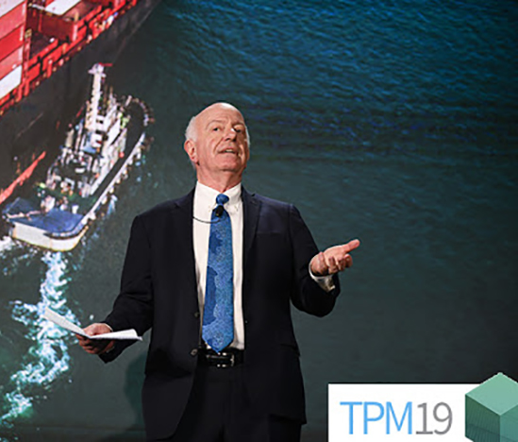
Odds of global recession low, but growing
IHS Markit chief economist Nariman Behravesh:
Slowing global economic growth puts the odds of a global recession at 50-50.
US economy, after growing 2.9% in 2018 as a result of the 2017 tax cuts, will slip to 2.4% growth in 2019 and 2% growth in 2020.
When growth is slowing, it doesn’t take much to push an economy over the edge.
China and EU manufacturing sectors already in recession.

Slide 4
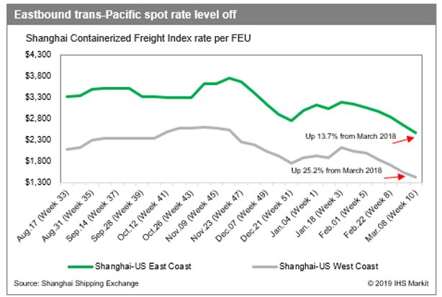
Trans-Pacific container supply-demand balance improving
Carriers showing greater capacity discipline with blank sailings – about 36 so far this year.
Spot rates in April remain strong for this time of year. $1,600 to West Coast 44% higher year-over year.
2018 US imports increased 9.1% from 2017, although analysts project only 2-3% growth in imports in 2019
2019 service contracts showing 20% rate increases from last year’s levels.
$1,250 to West Coast for biggest BCOs, $2,400 to East Coast. Smaller BCOs/NVOs paying $1,400+ West Coast
Alphaliner: No capacity increase in trans-Pac first time since 2009.

Slide 5
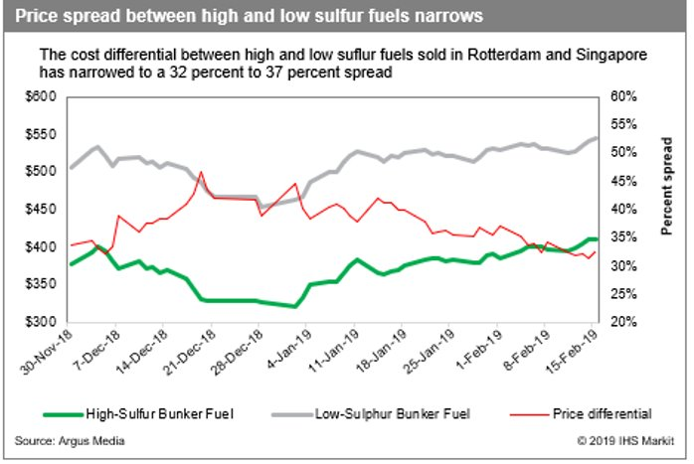
Balance gives carriers leverage
JOC shipper survey: 50% of respondents expect fuel costs to rise 10-30% in contracts (in addition to base rate increases).
Real challenge in setting BAFs: understanding the underlying numbers so customers feel BAFs have clarity
Carriers by Q4 expect to pass on most if not all of increased fuel costs to customers.
Lars Jensen at TPM: Low-sulfur fuel charge is not a give and take – BCOs will pay the full amount

Slide 6
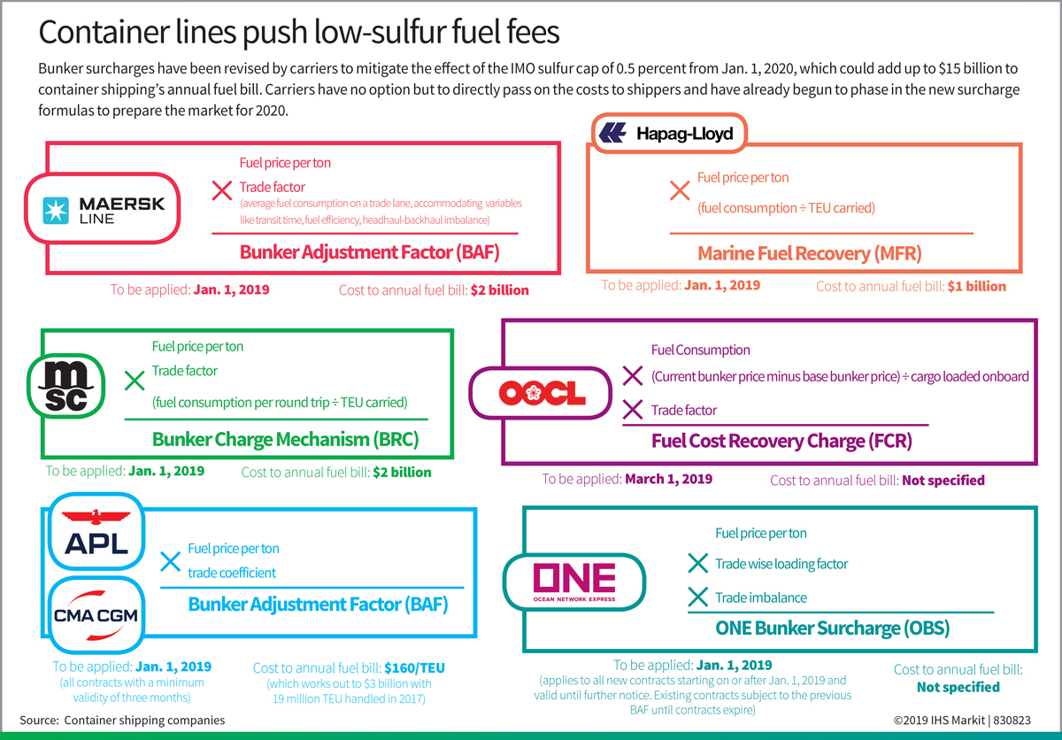

Slide 7
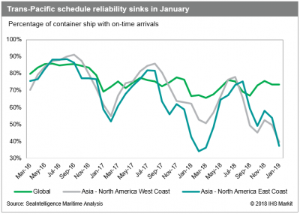
Where's my cargo? Ocean reliability frustration mounts
Carrier on-time reliability in trans-Pac plunges below 40%
"When my shelves are empty and customers can’t get product, that’s what keeps me up at night,” Kim Vaccaro, senior manager of international operations for Home Depot.
Extra-loaders last fall overwhelmed terminals and import warehouses
Better forecasting would help mitigate problems with terminal and surface transportation reliability.
Excessive delays created artificial truck/rail capacity shortages.
1/2

Slide 8
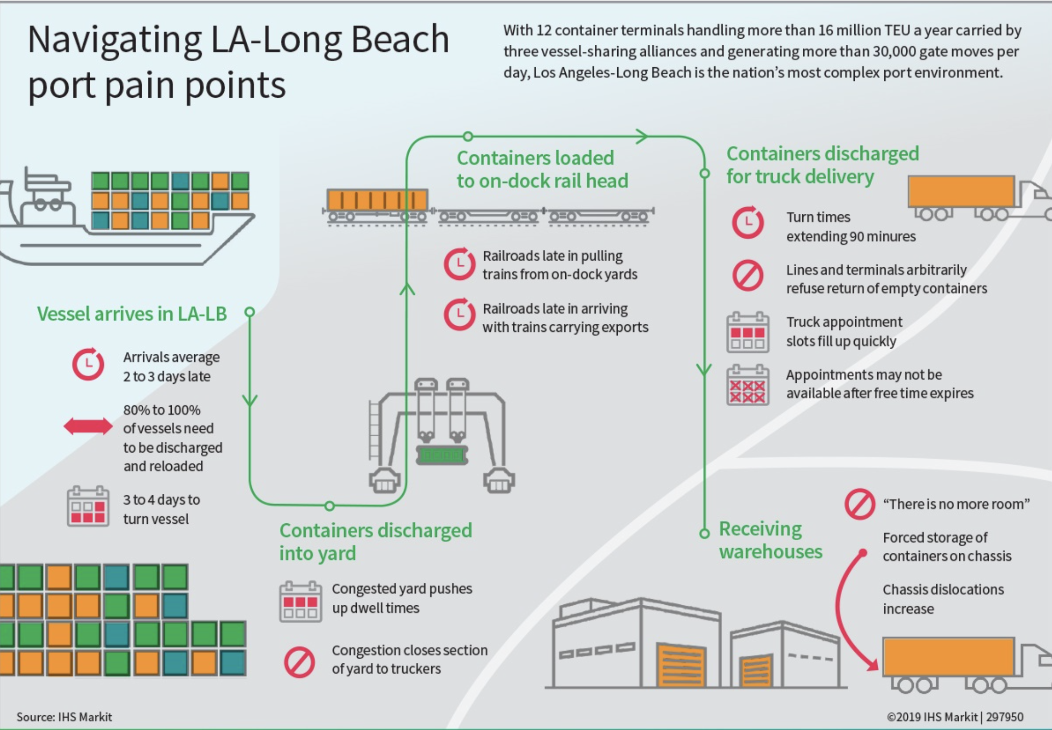

Slide 9
The US trucking market no longer over-heated
2018 marked by tight trucking market much of year, but so far in 2019 sufficient trucking capacity.
Weaker freight demand and higher truck capacity putting lid on rates
Truck rates this year are flat, and Chainalytics reports rates could turn negative this year if volumes slow down?
Last fall BCOs increased their business with NVOs and 3PLs who could get them vessel and truck capacity when both in short supply.
Continued uncertainties over Trump tariffs and last fall’s front-loading of imports are robbing 2019 truckers of freight.
Notes:
MUDDY MIDDLE: So what does Brian Reed of Geodis mean about the muddy mile? We're in a transition year, and spot rates are going down, for sure, but the economy is still strong, especially if China trade deal is hashed out, so what happens in the spring and summer? Hard comps in 1H19, but not so bad in 2H19. So do spot rates continue the nosedive or do they rebound?
CAPACITY AVAILABLE: We are seeing a reverse of what happened jut 12 months ago. Last March, everyone was scrambling for capacity, the spot market was so chaotic that shippers started moving freight to the contract market. Shippers swallowed the 15%, which was really three years of increase into one (2016, 2017, 2018), and the shipper wanted a guarantee capacity would be available. Tender acceptance rates of at least 90%. So what happens? Freight in the spot market is now converted to the contract market. Spot market demand wanes, prices fall. Now it's swung enough in the other direction that shippers are looking at the spot market and moving some freight back from contract to spot because rates are so cheap. We're back to 2017 levels.
YOU SAY GOODBYE: A shipper might bid out a lane, get asset-based carrier quotes, and then go to C.H. Robinson and see if they can beat it. In many cases, even with the brokerage margin, C.H. Robinson can. "A lot of shippers who started the process in the third or fourth quarter, they saw the rates [moving] in the right direction for them, so they actually held out on releasing the awards until mid-January or even into February,” said Mark Ford, chief operating officer with BlueGrace Logistics
DIFFERENT TRUCKING COMPANIES: Think of it as accessing two very different parts of the trucking industry. Contract carriage gets tendered to the big boys, J.B. Hunt, Schneider, Knight-Swift, Prime, Werner. Spot markets are where you can access the small carriers, many with fewer than 5 trucks. Brian Reed says you don't have to pick one or the other, use them in concert with each other. You don't have to pick one.
LEAVE AND RETURN: Brokers are popular when capacity is really, really tight or really, really soft. Do 3PLs like being dropped and then brought back again and again? No! But is it bad to be a transactional shipper? No. You can be one. You can view a 3PL as only a broker. Others see value in other services such as supply chain consulting. But can't an asset-based carrier or 4PL help with this too?
ANTAGONISM: Brian Reed said that shippers were really, really good at beating down the carriers in 2016. Carriers were really, really good at getting every cent they could from shippers in 2018. Did you see truckers say we'll meet you in the middle in 2018? Did shippers say we'll meet you in the middle in 2016? Nope. It's a bitter fight over every cent per mile. Will this paradigm ever change? Should it change?

Slide 10
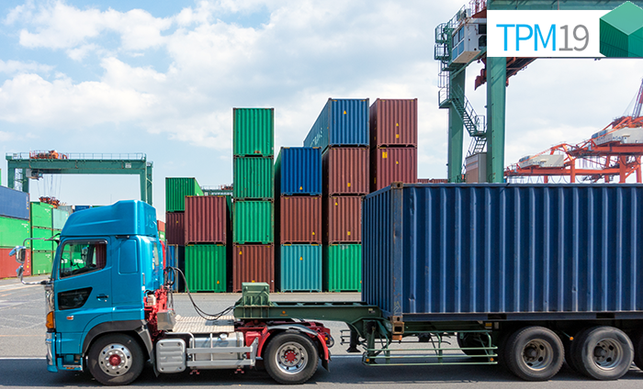
Merchant or carrier haulage?
The question is about trucks and invoicing.
Carriage haulage allows BCOs to focus on their core business rather than handling trucking invoices.
It's also a question of chassis, which in LA-LB seem to frequently be in short supply.
Carriers hesitate taking on new carrier haulage accounts
Picking carrier haulage doesn't mean you don't get involved in the process at all.
Visit the terminal, visit the ocean carrier, meet people.
Notes:
Time, as much as rising drayage costs, is forcing US importers to decide between container shipping line-arranged door moves and making their own surface transport arrangements through merchant haulage.
INLAND TRANSPORTATION: The ocean portion is the same no matter which model you use. The question is how much control and choice do you want on the inland portion? If service and reliability are your top concerns, you may want to use merchant haulage or carrier haulage with a customer nominated trucker. Ocean carriers have the reputation of not really providing satisfactory inland transportation when they handle the dray. If price and simplicity are your top concerns, then carrier haulage is better because it's cheaper and everything goes on a single invoice. Less overhead. One bill.
GAVLE: (Gav-LEE) In his case, Rockport sells shoes. Gavle doesn't want to spend overhead on invoices from an ocean carrier, a trucker, and a chassis provider. He doesn't need or want back office staff to process all the paperwork. Send him one bill, that's what he wants. Time is not an issue for them because there aren't rapid changes in the fine shoe industry. There not Nikes!
SYMONANIS: Cotton exporter. There is a lot of competition from overseas cotton manufacturers. Cotton is special to the US. Their customers expect goods to an overseas market on time. His team is willing to pay more money to make sure they know the trucker, they know where he is, they know he'll make the cutoff for the train to the port, they know the container will arrive in the port in time for the vessel it's scheduled to leave on. They are willing to pay more to be on time, every time.
CHASSIS: Same concern. There simply aren't enough chassis in the US. Under carrier haulage, you are getting a chassis at a really, really, really cheap rate. $6-$9 per day, even though it's baked into your quote. Over a full year, you could save $100,000 or more on chassis if you use them 5 days. But there are so many chassis shortages, Chicago, Memphis, LA. So you risk waiting for your container, incurring trucker detention or demurrage if there isn't a chassis available in the specific pool you are required to use. With a trucker owned chassis or just choice, unlikely to have a shortage, detention or demurrage, but you're paying $13-$15 with NACPC and $20-$30 for DCLI, TRAC!!! In essence, your DCLI and TRAC chassis are subsidizing carrier haulage.
GET INVOLVED: Carrier haulage isn't a turnkey operation. You want to know which terminal your string is calling. Is it an efficient terminal or is it a difficult one? Would you pay more to get into a good terminal like YTI or Middle Harbor, or Maher in NY/NJ? Make sure the ocean carrier is sound financially. Don't want another Hanjin. Do a customer nominated trucker. Invoice still goes to ocean carrier but at least you know who you're getting.
MEET PEOPLE: Networking is so important. In merchant haulage, visit the terminal staff, get to know who runs the day to day operations. Keep in touch. Same thing with the ocean carrier. Network. If something goes wrong, putting a face to the name and having a friendly relationship could be the difference between a favorable and unfavorable result.
The middle way? "Previously, I had a hybrid solution, carrier haulage rates, and merchant haulage service," said Dean Tracy, executive vice president and chief operating officer of RCS Logistics. NVOs are now offering door-services essentially. One invoice, they control everything such as chassis.

Slide 11
Big Trends: Interoperability and Predictive Visibility
Interoperability of systems a growing need – will that negate need for standards?
Focus on visibility has changed from in-transit to predictive.
Port portals offered by GE Transportation and Advent eModal gaining traction
Provide single window for truckers and BCOs to marine terminal environment in real time

Slide 12
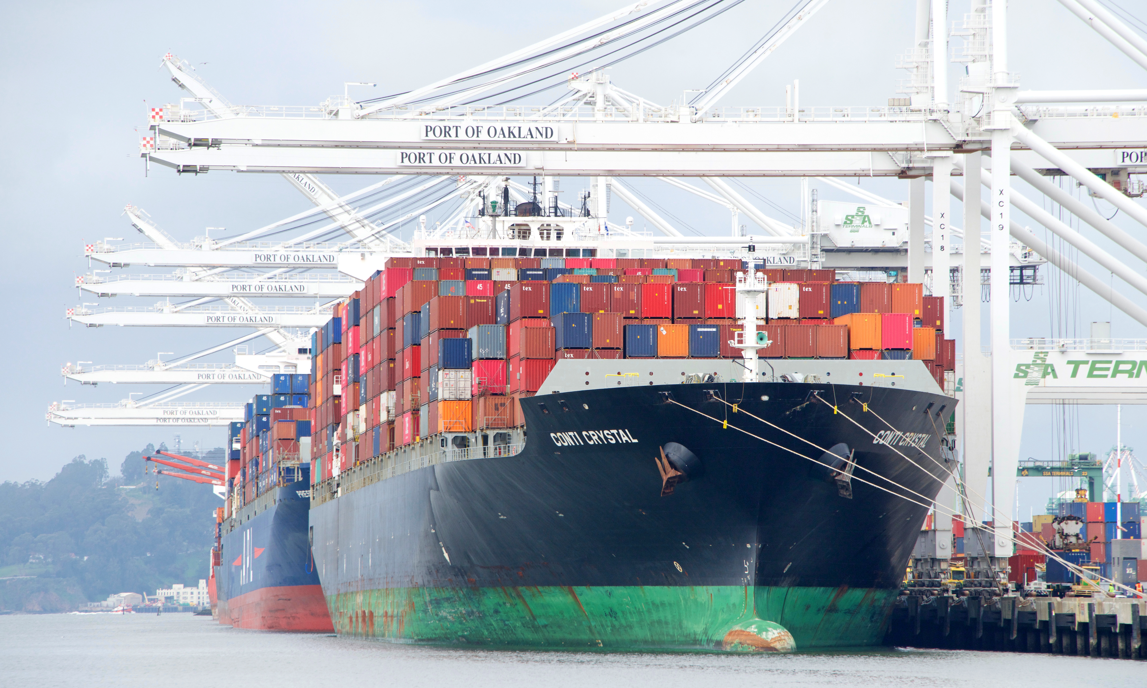
Port of Oakland Challenges and Opportunities
Last year was good – total container volume increased 5.2 percent to 2.55 million TEU.
Volume up 4.2% in Q1 2019
Process improvements drive performance: night gates, truck appointments, inland depots
Cool Port open. Work continues on Army Base logistics center
Modest TEU growth anticipated going forward commensurate with overall US trade growth
Baseball stadium?

